Slide 1
Vendosja e Headers dhe Footers
TIK 12 – Prof. Blerand Koshi

Slide 2
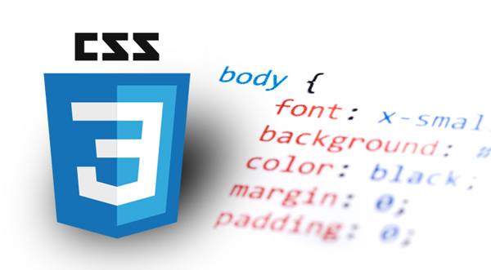
Vendosja e Headers dhe Footers
Shumica e webfaqeve kanë nga një Header dhe Footer
Header - zakonisht përdoret për vendosjen e titullit të faqes apo menysë
Footer - përdoret për të dhënë informata shtesë si psh. Copyright 2022 Loyola

Slide 3
<!doctype html>
<html>
<head>
<title>Two Column With Header and Footer</title>
<link rel="stylesheet" type="text/css" href="final.
css">
</head>
<body>
<div id="container">
<div id="header">
<h1>This is my site!</h1>
</div> <!-- end header -->
<div id="menu">
<ul>
<li><a href="#">Home</a></li>
<li><A href="#">Services</a></li>
<li><a href="#">About Me</a></li>
<li><a href="#">Contact Me</a></li>
</ul>
</div> <!-- end menu -->
<div id="mainContainer">
<div id="content">
<h2>Here's some content</h2>
<p>This is where a story would go</p>
<h2>Here's more content</h2>
<p>This is another story</p>
</div> <!-- end content -->
<div id="sidebar">
<h3>Menu</h3>
<ul>
<li>Menu item 1</li>
<li>Menu item 2</li>
<li>Menu item 3</li>
</ul>
</div> <!-- end sidebar -->
<div id="footer">
<p>Copyright (c) 2012 Steve Suehring</p>
</div> <!-- end footer -->
</div> <!-- end mainContainer -->
</div> <!-- end container -->
</body>
</html>

Slide 4
body {
font-family: arial,helvetica,sans-serif;
}
#container {
margin: 0 auto;
width: 100%;
}
#header {
background-color: #abacab;
padding: 10px;
}
#menu {
float: left;
width: 100%;
background-color: #0c0c0c;
}
#menu ul li {
list-style-type: none;
display: inline;
}
#menu li a {
display: block;
text-decoration: none;
border-right: 2px solid #FFFFFF;
padding: 3px 10px;
float: left;
color: #FFFFFF;
}
#menu li a:hover {
background-color: #CCCCCC;
}
#mainContainer {
float: left;
width: 100%;
}
#content {
clear: left;
float: left;
width: 65%;
padding: 20px 0;
margin: 0 0 0 5%;
display: inline;
}
#sidebar {
float: right;
width: 30%;
padding: 20px 0;
margin: 0;
display: inline;
background-color: #CCCCCC;
}
#footer {
clear: left;
background-color: #CCCCCC;
text-align: center;
padding: 20px;
height: 1%;
}

Slide 5
?
Pyetje

